Slide 1
How are CCE Organized?

Slide 2
1
Task Overall and Introduction
2
Ideas and Method
目
录
3
Task Solution
4
Summary and Experience

Slide 3
1
Task Overall

Slide 4

1
Task Overview
Task Overview
How the REs are organized into CCEs with 1.4MHz bandwidth and CFI = 2?
In this part, we are going to talk about how REs are organized into CCEs, with 1.4MHz system bandwidth and CFI equals to 2, step by step.

Slide 5
2
Ideas and Methods

Slide 6
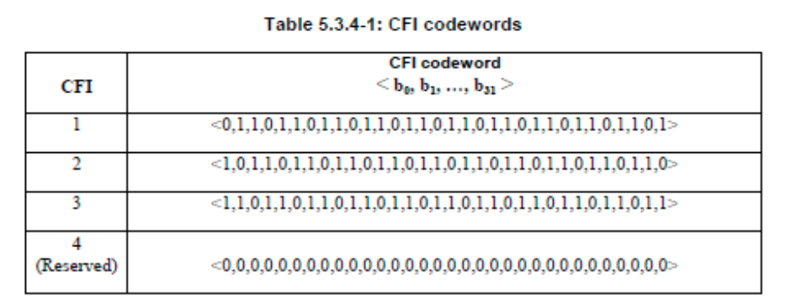
2
Methods and Idea
Code Overview
CFI is an indicator telling how many OFDM symbols are used for carrying control channel (e.g, PDCCH and PHICH) at each subframe. (TS36.212 v13 5.3.4)
CFI is transmitted via QPSK, through a special channel called PCFICH
Since CFI is given as 2 in this scenario, this CFI codeword is what we want.

Slide 7
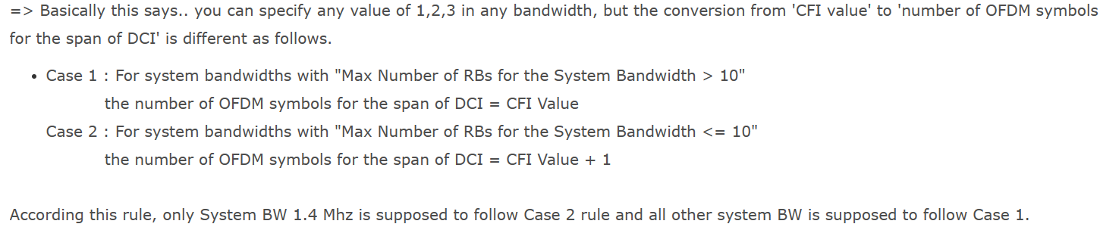
2
Methods and Idea
Code Overview
According to the relevant explanation in 3GPP 36.212 version 5.3.4 above, since each subcarrier (RE) occupies a bandwidth of 15kHz and each resource block (RB) contains 12 subcarriers, the total bandwidth occupied is 180kHz. In the case of a 1.4MHz operating bandwidth, it falls under case 2, where the span of the DCI in terms of OFDM symbols is CFI+1.
So CFI = 2 means the span of the DCI in terms of OFDM symbols is 3.

Slide 8
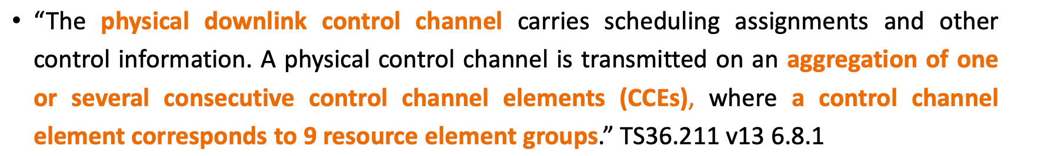
2
Methods and Idea
CCE Organization
From slides, we can know that each CCE consists of 9 REGs, while each REG consists of 4 REs
Since QPSK is used for CCE, each CCE consists of 72 bits.

Slide 9
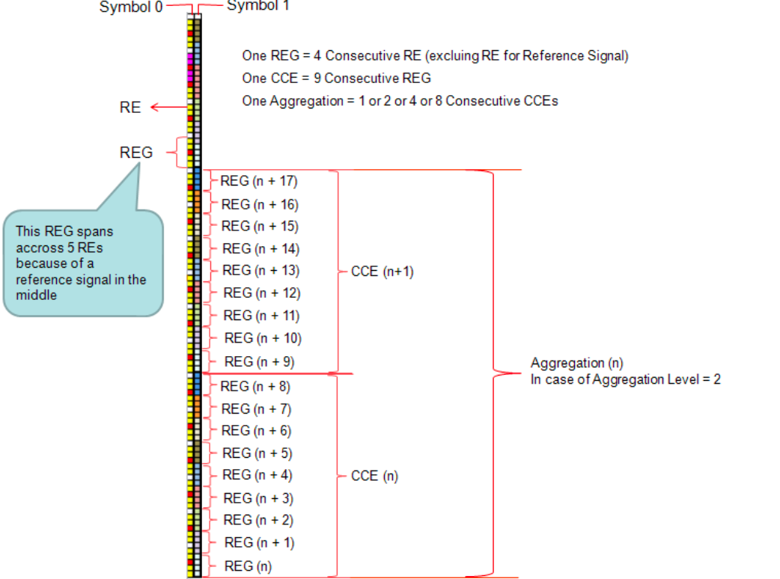
2
Methods and Idea
CCE Organization
From slides, we can know that each CCE consists of 9 REGs, while each REG consists of 4 REs.
Since QPSK is used for CCE, each CCE consists of 72 bits.

Slide 10
2
Methods and Idea
CCE Organization
From slides, we can know that each CCE consists of 9 REGs, while each REG consists of 4 REs.
Since QPSK is used for CCE, each CCE consists of 72 bits.

Slide 11
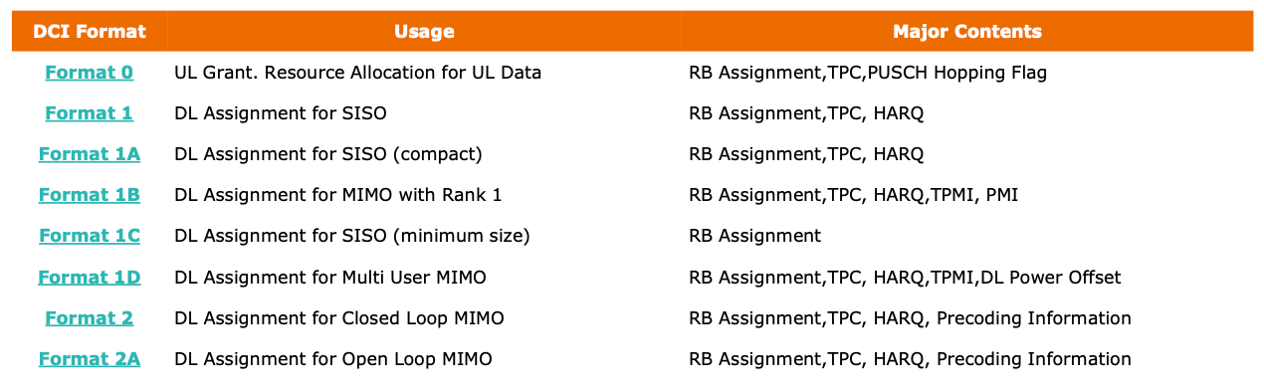
2
Methods and Idea
CCE
CCEs can be used to transmit DCI(Downlink Control Indicator), DCI maintains at least the following information • which resource blocks carry your data • what kind of modulation and coding scheme is used for the data transmission
• One DCI is carried by one or multiple CCE (CCE Aggregation)

Slide 12
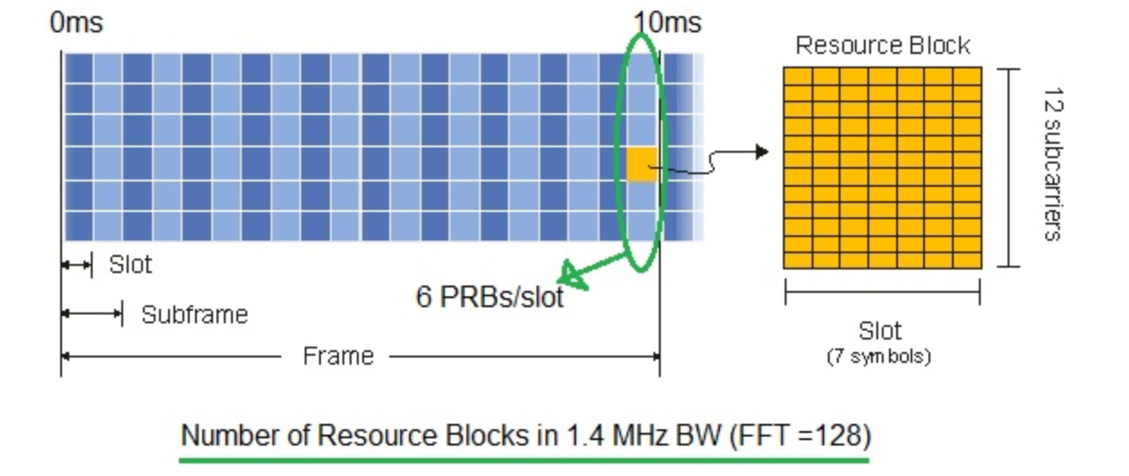
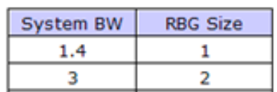
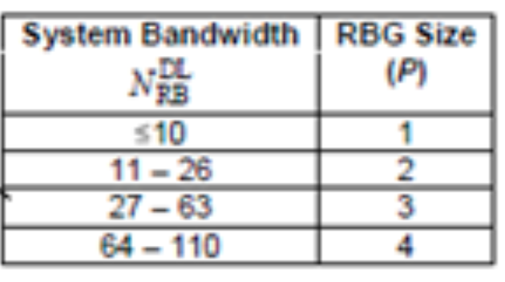
2
Methods and Idea
CCE
For 1.4MHz system, there are 6 RBs in one slot, hence 12 RBs in one subframe.
And each subframe, there are two symbols being used to transmit control info. And RBG size equals to 1, from given table.

Slide 13
2
Methods and Idea
CCE
For 1.4MHz system, there are 6 RBs in one slot, hence 12 RBs in one subframe.
And each subframe, there are two symbols being used to transmit control info.
There are 12 x 6 = 72 REs in each symbol
(or calculated by 12 subcarriers x 7 symbols per slot / 7 symbols per slot x 6 RBG per slot x 1 RB per RBG)

Slide 14
2
Methods and Idea
CCE
So, we have total REs of 72 x 2 = 144 REs to transmit control info.
Note that, each CCE contains 4 x 9 = 36 REs. So, we may use 144/36 = 4 CCEs, arranged in aggregation way, to transmit control information.

Slide 15
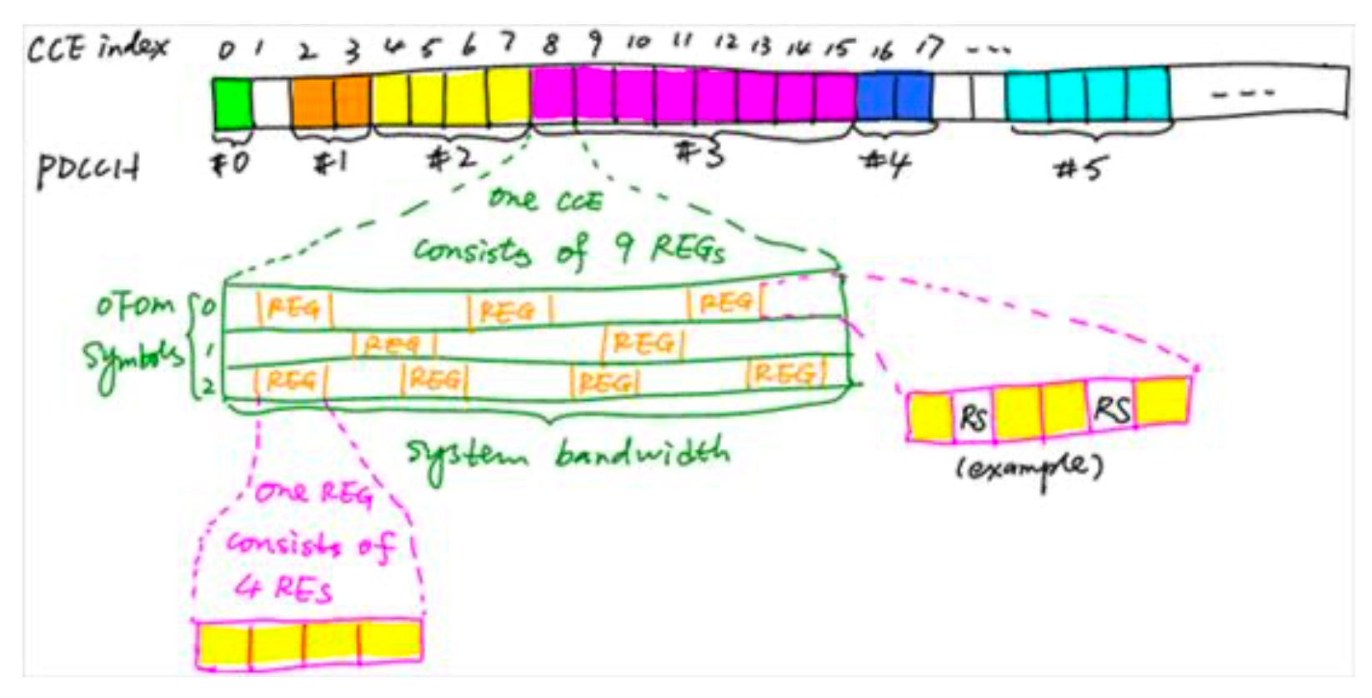
2
Methods and Idea
CCE
Note that, each CCE contains 4 x 9 = 36 REs. So, we may use 144/36 = 4 CCEs, arranged in aggregation way, to transmit control information. And each CCE contains 3 OFDM symbols, each symbol will arrange their REGs

Slide 16

Thanks for Listening !

